Slide 1
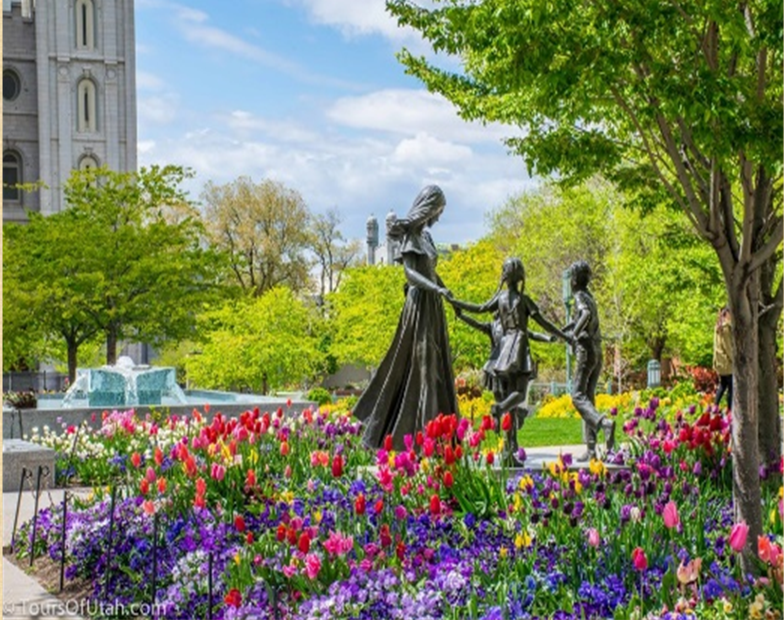

Website Planning Document Term Project – Temple Inn & Suites
Jason Goudie | CIT 230 | BYU Idaho
Site Plan for

Slide 2
Site Plan for
Site name
www.templeinnandsuites.com
Site Purpose
Website for Temple Inn and Suites
The Temple Inn & Suites is a hotel chain headquartered in Bethesda, MD that builds and manages specialized hotel accommodations near temple locations of The Church of Jesus Christ of Latter-day Saints around the world. The owner-operated company caters to temple workers, patrons, and their families by providing specialized services and accommodations that meet the needs of those patrons. The hotel accommodations and services are available to anyone willing to abide by the terms and policies outlined by the company. The overall goal of the website project is to promote and provide information about the specialized services that this hotel chain offers to meet the needs of temple patrons who come to serve in the temple or who participate in events such as sealings, weddings, receptions, and youth trips. The website should reflect the Church culture and be designed to support a temple oriented theme as well as the concept of being a haven of comfort and accessibility.

Slide 3
Site Plan for
Target Audiences
Service mostly LDS temple attending individuals, temple missionaries
Create a unique atmosphere for people to stay at multiple sites around the country by temples and give them incentives to visit all of our sites.
Specialized Services
Free access to changing rooms and bathroom facilities for temple patrons who have traveled far and need to change to and from church clothes
A playroom and low-cost, short-term babysitting services for the children of patrons
Long-term stay accommodations in kitchenette suites for full-time temple missionaries
Temple history themed reception and sitting area
A wedding reception hall that can be easily customized with a simple catering menu and kitchen access for food preparation and serving
A family search center that supports family search and ordinance work
[Other ideas are welcome]
Free Amenities
Breakfast
Exercise/workout room
Indoor pool
WiFi high-speed internet access and smart TVs
Parking
Temple shuttle
Family history consultation and family ordinance card service

Slide 4
Site Plan for
Site Map
Home
About
Temples
Reservations
History
Locations
Gallery
Receptions
Temple Missionaries
Columbus, Ohio
Indianapolis, IN
Washington DC
Chicago, IL
Services
Contact

Slide 5

Site Plan for
Branding
We will prodigiously use the name thefatguyforecast.com and the lightning fist logo according to PARC web design principles. We plan to use this same branding as you see here in the site plan. Logo, background
Color Scheme
The trademark colors of the site will be a gray and orange.
Gray (RGB 118, 118, 118) Hex Code #767676
Orange (RGB 237, 125, 49) Hex Code #ED7D31
Typography
The main for the site will be Berlin Sans FB
Font Examples
Berlin Sans FB 16px
Berlin Sans FB 20px
Berlin Sans FB 24px

Slide 6
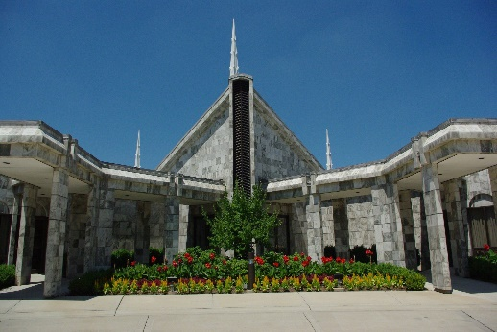
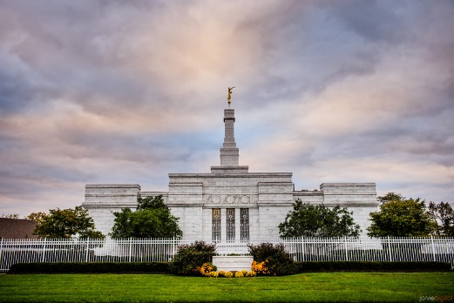
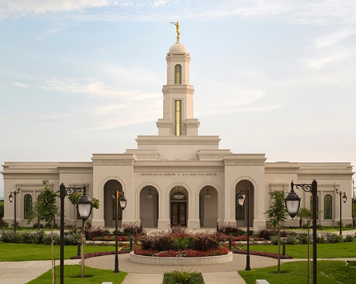
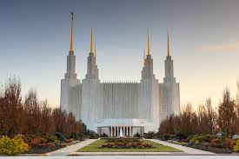
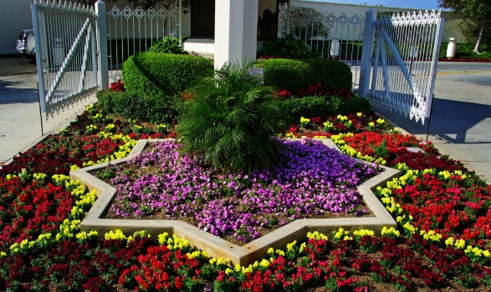

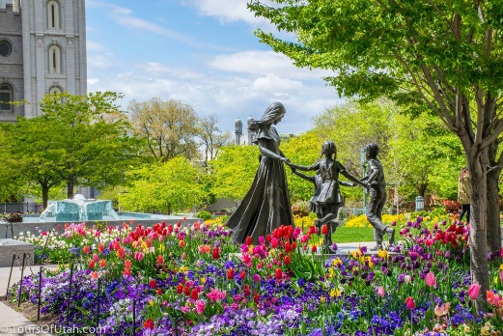
Site Plan for
Graphics
We will use photos with permission of the temples, our locations, services and amenities.
We will also use beautiful landscapes and flowers to create a warm inviting environment.

Slide 7

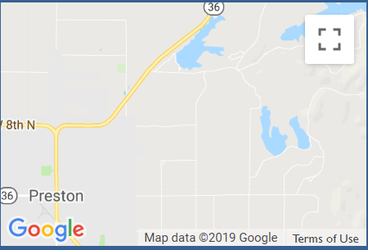
Site Plan for
Wire Frames Small
Home
About
Temples
Reservations
Services
Welcome to Temple Inn & Suites
We provide a unique atmosphere for LDS temple attending individuals, temple missionaries and anyone who just wants to enjoy a nice place to stay.
People can stay at our multiple sites around the country by temples and join our rewards program and receive incentives to visit all of our sites.
1234 Temple Road,
Bethesda, MD 12345
800-Temples
info@templeinnandsuites.com

Slide 8
Site Plan for
Wire Frames Medium
Home
About
Temples
Reservations
Services
Welcome to Temple Inn & Suites
We provide a unique atmosphere for LDS temple attending individuals, temple missionaries and anyone who just wants to enjoy a nice place to stay.
People can stay at our multiple sites around the country by temples and join our rewards program and receive incentives to visit all of our sites.
1234 Temple Road,
Bethesda, MD 12345
800-Temples
info@templeinnandsuites.com

Slide 9

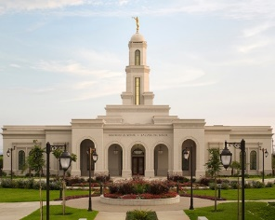
Site Plan for
Wire Frames Large
Home About Temples Reservations Servcies
Welcome
Welcome to Temple Inn & Suites
We provide a unique atmosphere for LDS temple attending individuals, temple missionaries and anyone who just wants to enjoy a nice place to stay.
People can stay at our multiple sites around the country by temples and join our rewards program and receive incentives to visit all of our sites.
1234 Temple Road,
Bethesda, MD 12345
800-Temples
info@templeinnandsuites.com

